Slide 1
XDS.b + Blockchain
Petnathean Julled

Slide 2
Content
Paper reviewed about Searching on Blockchain
Design of our system (animation)

Slide 3
Review paper about search for transaction on Blockchain
Why we seek for this?
When we need to discover specific transaction within Blockchain, how can we do it?
The challenge is that Blockchain have large amount of transaction
And Ethereum rely on ‘Eth address’ to discover each transaction, which mean anyone who want to access transaction on Ethereum Blockchain need to knew its Eth address before hand.
Is it possible to execute smart-contract to search for transaction within the chain?
Are there any efficient way that people are using to discover transaction within Blockchain, especially Ethereum Blockchain.
So, we need to see how people are doing on this topic.

Slide 4
Ethereum Query Language Link
Addressing problem
Massive data of Ethereum Blockchain (300GB+)
Heterogeneous data
Ethereum require direct access to each object with its unique ID
Currently there are 2 options to discover and read transaction in Ethereum
direct access each block with the specific information, which would require for the owner to know beforehand the blocks’ hashes or numbers
access the most recent block and sequentially search every parent block for any information related to the account
*After the owner acquires the information he still needs to extract it from the stored representation and reformat it for a better visualization.
Data opaqueness as to reduce size of data representation but not give much hint of its meta data
They proposed EQL (Ethereum Query Language)
EQL give better query experience for user-perspective
EQL perform search by using sequential searching method
EQL give SQL-like interface for user to search for stuff in Ethereum Blockchain

Slide 5
Ethereum Query Language Link
What idea we get
As they mentioned that there are 2 ways of discover transactions within Ethereum Blockchain
We can adopt sequential search method for first time search
Then use off-chain application to remember contract eth address for faster access on next time.

Slide 6
Query Support for Data Processing and Analysis on Ethereum Blockchain Link
This work proposed as additional improvement of EQL
The work provide more functions as interface for developer to query transaction from Blockchain based on Ethereum Query Language.
They also utilize cloud storage to handle account, block, and transaction information retrieved from the chain.
This work give an example of using off-chain storage to handle stuff from Blockchain.

Slide 7
Analytic tools on Blockchain Link
Review Blockchain analytic tools (Mostly Bitcoin and some general Blockchain)
Focus on discuss about future of analytic tools and possibilities
Analytic tools for real-time analysis
Analytic tools for Big-data and data visualize
However, what these tools actually done is sequentially index all transaction in the chain to off-chain database and give interface to user.

Slide 8
Analytic tools on Blockchain Link
For Ethereum there are many available tools to explore main chain
Etherscan
Etherchain
Ethplorer
Blockchair – Ethereum
Gastracker
And some API tools to explore private chain
Infura
Each tools have different features centered around Eth address, Gas price, Gas limit, difficulty, and other general index included in each Block and transaction of Ethereum by default. More than these are UI.

Slide 9
Mystiko – Blockchain Meets Big Data Link
This work proposed ‘Mystiko’ Blockchain concept that more compatible with Big data or data analysis application.
This work represent limitation of many existing Blockchain platform in term of data discovery.
Additional reason why we need to use sequential search method as we use Ethereum for our implementation.

Slide 10
Blockchain as an Audit-able Communication Channel Link
In the scenario that applications requiring strict access control (e.g. medical record query) often require auditing of the query.
This work propose that query logging will record into Blockchain instead of traditional server which vulnerable to data tamper.
Scheme proposed by this work is similar to idea for document retrieval history record in our work as we want to record activity of document retrieval into Blockchain.

Slide 11
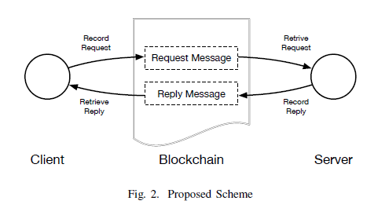
Blockchain as an Audit-able Communication Channel Link

Slide 12
Enabling Reliable Keyword Search in Encrypted Decentralized Storage with Fairness Link
This work propose keyword search function over encrypted file in decentralized storage setting.
Blockchain also become where they record search evidences (search history).
Keyword search over encrypted data utilized symmetrical cryptography to allow search of data with specified index.
This work give useful idea if we need to encrypt everything on Blockchain while need those data to be discoverable by keyword search.

Slide 13
*Block-based Access Control for Blockchain-based Electronic Medical records (EMRs) Query in eHealth Link
This work proposed an access control solution for exchanging Blockchain-based Electronic Medical Records called BBAC Scheme.
The work presumed that EMR Server is Blockchain that act as EMR
The work center around using cryptographic scheme for access control to EMRs
They separate entities involved with the system to 2 groups
Users: represent data inquirers like doctors, patients, and data analyst.
EMR Server: store all the electronic medical records and verify the access permissions and authorize the block(s) access.
Core point of the work is that there will be cryptographic process to control authorization before any Users can access EMRs
Scenario of this work is similar to MedRec but different method

Slide 14
*Blockchain Support for Flexible Queries with Granular Access Control to Electronic Medical Records (EMR) Link
Published by the same publisher from previous paper
Based on EMRs Blockchain, this work proposed an architecture called “Granular Access Authorisation supporting Flexible Queries” that comprises an access model and an access authorization scheme.
This work focus on authorization scheme with granular access control that support flexible data queries.
By add index attribute of data into cryptographic scheme, this work allow query of data within EMR Blockchain.
Unfortunately, EMR Blockchain in this work is not based on any notable Blockchain platform. So, it’ll be difficult for us to adopt their scheme to our work.

Slide 15
Blockchain-based System for Secure Data Storage with Private Keyword Search Link
This work provide a way to retrieve private data from cloud while record the action into Blockchain as evidence without expose content in the data to cloud service provider

Slide 16
Searching an Encrypted Cloud Meets Blockchain: A Decentralized, Reliable and Fair Realization Link
Another approach for keyword search over encrypted data with Blockchain record search evidences.

Slide 17
Accelerating Blockchain Search of Full Nodes Using GPUs Link
Proposed about using GPUs (Graphical Processing Unit) to accelerate search ‘Full node’
‘Full node’ mean Blockchain node that keep data of the whole chain. This require large volume of storage.
Alternatively, there is SPV node which keep some part of the chain or rely on trusted Full node to verify transaction. This more suitable with mobile device for user.
However, this work more focus on hardware and computational power. Not really related to our work.

Slide 18
PHI attributes
Health information that contain the following identifiers of the individual or of relatives, employers, or household members of the individual, are considered PHI (Protected Health Information):
Names
All geographic subdivisions smaller than a state, including street address, city, county, precinct, ZIP code, and their equivalent geocodes, except for the initial three digits of the ZIP code if, according to the current publicly available data from the Bureau of the Census:
The geographic unit formed by combining all ZIP codes with the same three initial digits contains more than 20,000 people; and
The initial three digits of a ZIP code for all such geographic units containing 20,000 or fewer people is changed to 000
All elements of dates (except year) for dates that are directly related to an individual, including birth date, admission date, discharge date, death date, and all ages over 89 and all elements of dates (including year) indicative of such age, except that such ages and elements may be aggregated into a single category of age 90 or older
Telephone numbers
Vehicle identifiers and serial numbers, including license plate numbers
Fax numbers
Device identifiers and serial numbers

Slide 19
PHI attributes
Email addresses
Web Universal Resource Locators (URLs)
Social security numbers
Internet Protocol (IP) addresses
Medical record numbers
Biometric identifiers, including finger and voice prints
Health plan beneficiary numbers
Full-face photographs and any comparable images
Account numbers
Any other unique identifying number, characteristic, or code, except as permitted by paragraph (c) of this section [Paragraph (c) is presented below in the section “Re-identification”]; and
Certificate/license numbers
*The covered entity does not have actual knowledge that the information could be used alone or in combination with other information to identify an individual who is a subject of the information.

Slide 20
PHI handling defined by HIPAA
The Privacy Rule was designed to protect individually identifiable health information through permitting only certain uses and disclosures of PHI provided by the Rule, or as authorized by the individual subject of the information.
Basic Principle.
A major purpose of the Privacy Rule is to define and limit the circumstances in which an individual’s protected heath information may be used or disclosed by covered entities. A covered entity may not use or disclose protected health information, except either: (1) as the Privacy Rule permits or requires; or (2) as the individual who is the subject of the information (or the individual’s personal representative) authorizes in writing.
To sum up, PHI require basic authorization that can control and identify who can access what information.

Slide 21
Case: Hacker gained access and compromised one node
They’ll have one copy of chain on hand
They have potential to access Protected Health Information within the chain.
This point that each node must have its own basic access control that force user to identify themselves before have permission to interact with the chain.
For Document Query, staff need to identify themselves within the transaction by default.
Within the chain, each PHI element should not be kept in plaintext.
Each node have key to access content of the chain.
Only authenticated user should be able to see PHI element using key belong to that node.

Slide 22
Summary got from paper reviewed
Search contract need to rely on sequential search method which sequentially look into each contract until find the transaction
Previously searched Eth address can be kept locally to allow faster search on future use of the same transaction
Addition
Need to identify about who issue contract
Each node need to provide basic authentication to identify who accessing the chain.
All content will be encrypted before entering the chain
Need to encrypt data as basic security to prevent easy access to Blockchain data
May need to reference HIPAA guide to de-identify data by remove 18 identifier that have potential to expose patient’s confidentiality and privacy

Slide 23
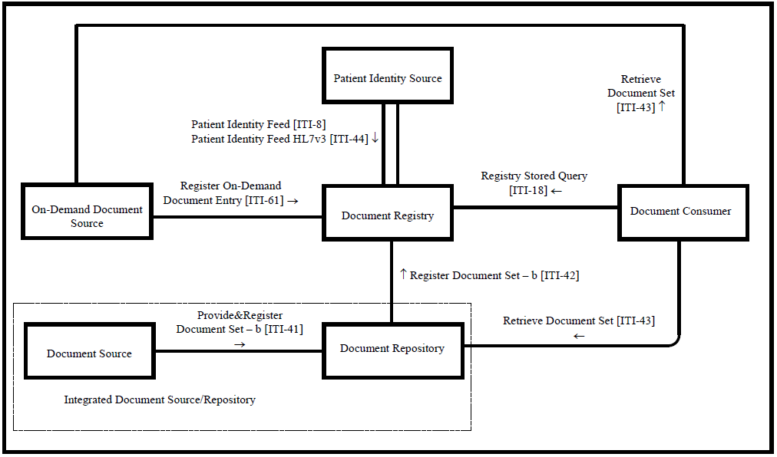
Design
Query
Contract
Document Registry Node
Transaction Search
Register Contract
Retrieve Contract
(From IHE ITI TF Vol. 1) Cross-Enterprise Document Sharing – b Diagram

Slide 24
Repository -> Registry -> Blockchain
Document Registry
Repository
(XDS Toolkit)
TCP
XML Parser
Registry Handler
Smart-contract
Factory
Document Consumer Client
Blockchain
Ledger
User
Authentication
Username: Password:
Other Nodes
Ethereum
ÐΞVp2p Wire Protocol

Slide 25
Repository -> Registry -> Blockchain
Document Registry
Document Regist Set-b
Repository
(XDS Toolkit)
XML Parser
Response
XML to Object

Slide 26
Repository -> Registry -> Blockchain
Document Registry
XML Parser
Registry Handler
Object

Slide 27
Repository -> Registry -> Blockchain
Document Registry
Registry Handler
Object
Smart-contract
Factory
XML
Object to XML

Slide 28
Repository -> Registry -> Blockchain
Document Registry
Smart-contract
Factory

Slide 29

Repository -> Registry -> Blockchain
Document Registry
Metadata Index for discovery
Received
Object
Smart-contract
Factory
Queue for verify (mine)
XML
Consensus
Publish on the chain
Encrypt
Document Registry Contract
Blockchain
Ledger

Slide 30
Search for Document Registry Entry
Document Registry
Repository
(XDS Toolkit)
TCP
XML Parser
Registry Handler
Smart-contract
Factory
Document Consumer Client
Blockchain
Ledger
User
Authentication
Username: Password:
Other Nodes

Slide 31

Search for Document Registry Entry
Document Consumer Client
Blockchain
Ledger
User
Authentication
Username: Password:
Search

Slide 32
Search for Document Registry Entry
Transaction 0x000001
Input search index
Transaction 0x000001
Patient Name:
‘John Doe’
Patient ID: ‘abc123’ Visit Time:
‘20 Oct 2018’
Patient Name:
‘****’
Patient ID: ‘****’ Visit Time:
‘15 July 2018’
Patient Name:
‘Alice Wonderland’
Patient ID: ‘jkl654’ Visit Time:
‘15 July 2018’
Decrypt

Slide 33
Search for Document Registry Entry
Transaction 0x000001
Transaction 0x000005
Transaction 0x000002
Transaction 0x000003
Input search index
Transaction 0x000004
Patient Name:
‘John Doe’
Patient ID: ‘abc123’ Visit Time:
‘20 Oct 2018’
Patient Name:
‘Alice Wonderland’
Patient ID: ‘jkl654’ Visit Time:
‘15 July 2018’
Patient Name:
‘John Doe’
Patient ID: ‘abc123’ Visit Time:
20 Oct 2018’
Case: Emergency
Patient Name:
‘James Bond’
Patient ID: ‘rty852’ Visit Time:
’20 Oct 2018’
Patient Name:
‘John Doe’
Patient ID: ‘abc123’ Visit Time:
’14 May 2017’
Patient Name:
‘John Doe’
Patient ID: ‘abc123’ Visit Time:
’20 Oct 2018’
False
True
False
True
True
False
True
False
True
True
False
True
True
False
True
???
Mismatch
Match
Mismatch
Mismatch
Match
Found list:
Transaction 0x000004
Transaction 0x000005

Slide 34
Query
Document Consumer Client
Blockchain
Ledger
User
Authentication
Username: Password:
Request Query
Tx 0x000004
Tx 0x000005
Smart-contract
Factory
Issue Document
Registry Query Contract

Slide 35
Query
Document Repository Location Received
Document Consumer Client
Blockchain
Ledger
User
Authentication
Username: Password:
Response
Transaction
Smart-contract
Factory
Document Registry Contract
Response

Slide 36
Retrieve
Selected Document Repository of
Tx 0x000004
Document Retrieval Contract
Document Consumer Client
User
Authentication
Username: Password:
Blockchain
Ledger
Contract Address
Document Repository

Slide 37
Retrieve
Document Consumer Client
User
Authentication
Username: Password:
Blockchain
Ledger
Contract Address
Approve
Document Repository
Document Retrieval Contract
Check

Slide 38
Retrieve
Document Received
Document Consumer Client
User
Document Retrieval
History Recorded
Authentication
Username: Password:
Blockchain
Ledger
Document
Document Repository

Slide 39
Encryption
Working on design encryption***
What data will need encrypt
Reference HIPAA 18 de-identify factor
How to deal with encryption key

Slide 40
Implementation (Implemented)
Ethereum Blockchain node setup
XDS Toolkit
Conformance Tools: Send transaction sample
Thank to XDS Toolkit implementer google group, so I able to send out transaction from XDS Toolkit
XML Receiver via TCP
XML Parser: Convert XML text to object for programming
*will make some small video shot to show you

Slide 41
Implementation (Next step)
XDS Response in XML format
Smart-contract factory

